Slide 1

GROUP 3 – FINANCIAL ANALYSIS
WHICH IS THE BEST SUPERMARKET FOR US TO INVEST IN?
Group Members:
Alex
Murali
Eleanor
Devon
Archie
Vavara
Zainab
Ayesha

Slide 2



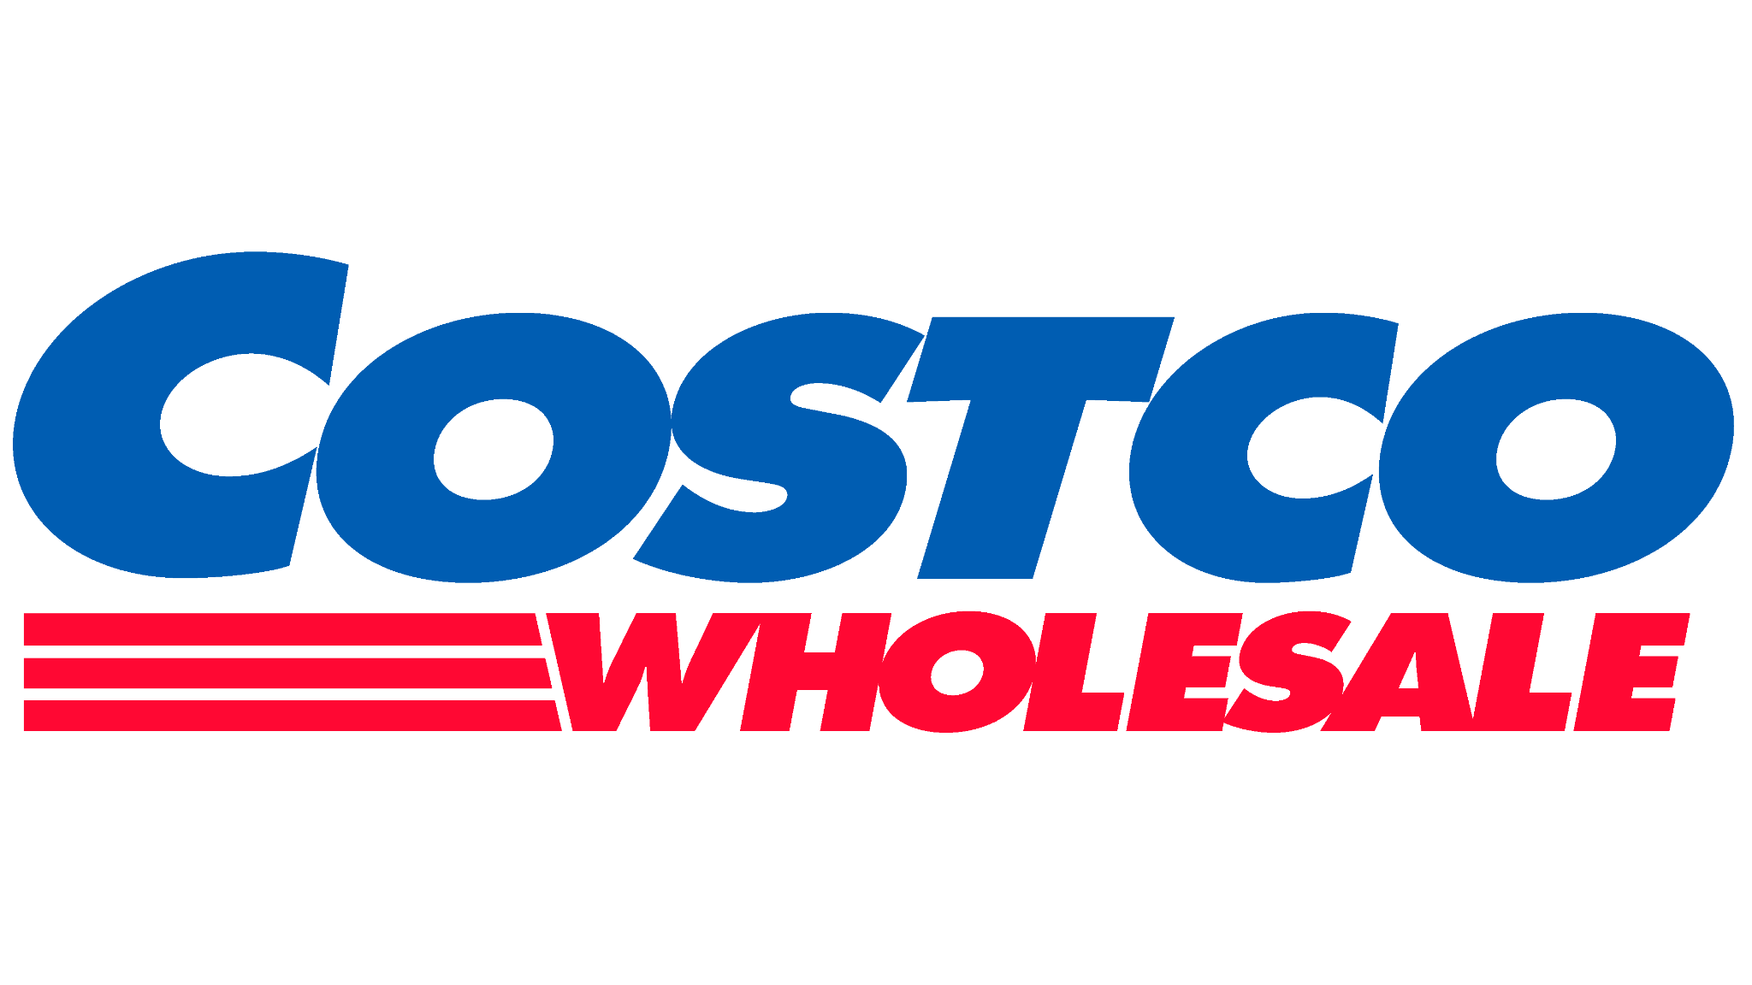
WHICH IS THE BEST SUPERMARKET FOR US TO INVEST IN?
Investment returns:
Increase in the Share Price ⬆
Dividend Amount ⬆
Dividend Frequency ⬆
Decision Aid:
6 Questions

Slide 3

METHODOLOGY
Data Source
Data Items
Date
Opening Stock Price
Closing Stock Price
Stock Volume Traded
Dividends

Slide 4
6 KEY QUESTIONS
How does the stock price change over time?
How are dividends treated by the company?
Does any of the stock have a greater degree of risk associated with it than the others?
Which stock gives us the greatest return on investment?
Is past financial performance a true indicator or future financial performance?
Are there any other factors that could influence our investment decision?

Slide 5
HOW DOES THE STOCK PRICE CHANGE OVER TIME?
To compare this, the increase of stock price was looked at in percentage terms over the last 5 years.
We took the view that a longer time frame theoretically would allow us to make more concrete conclusions as specific events could be “evened out” and not skew the data as much.
Actual price was not considered – the actual stock price is more a barrier to entry rather than a measure of performance.

Slide 6
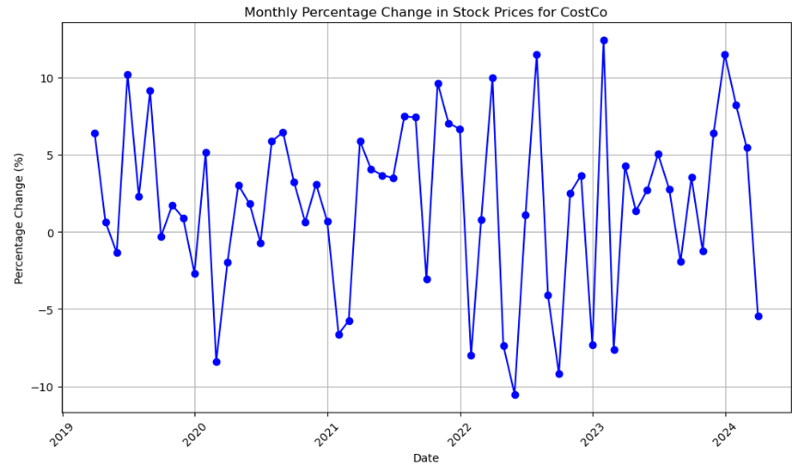
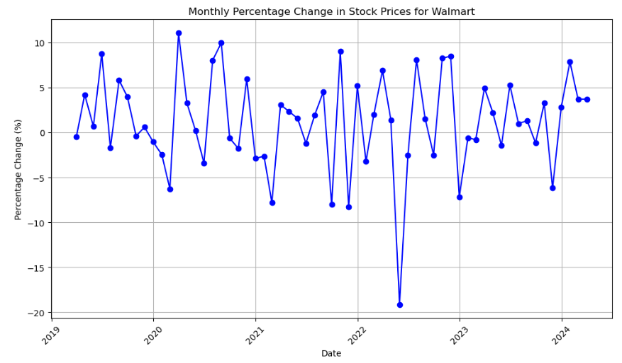
HOW DOES THE STOCK PRICE CHANGE OVER TIME?

Slide 7
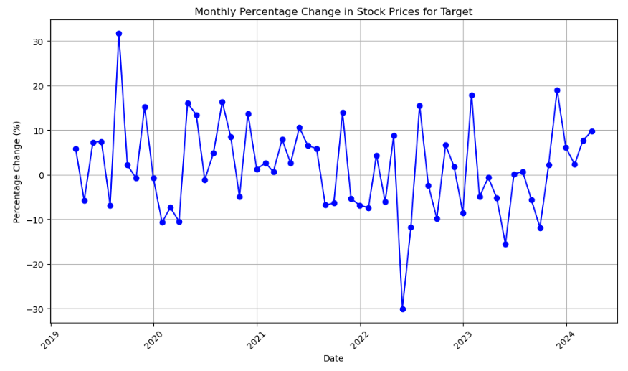
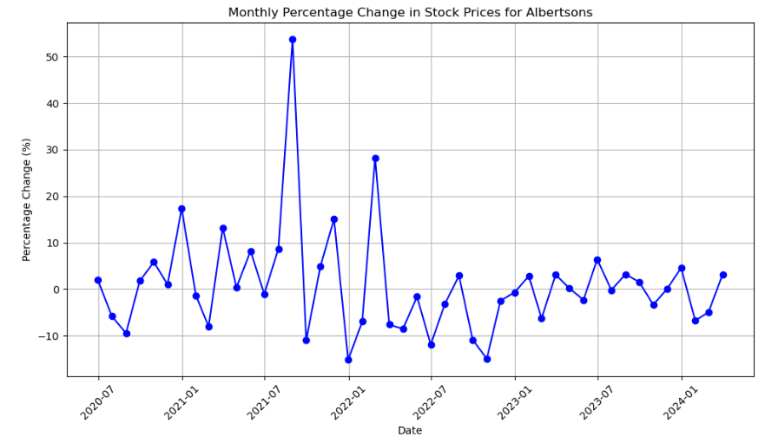
HOW DOES THE STOCK PRICE CHANGE OVER TIME?

Slide 8
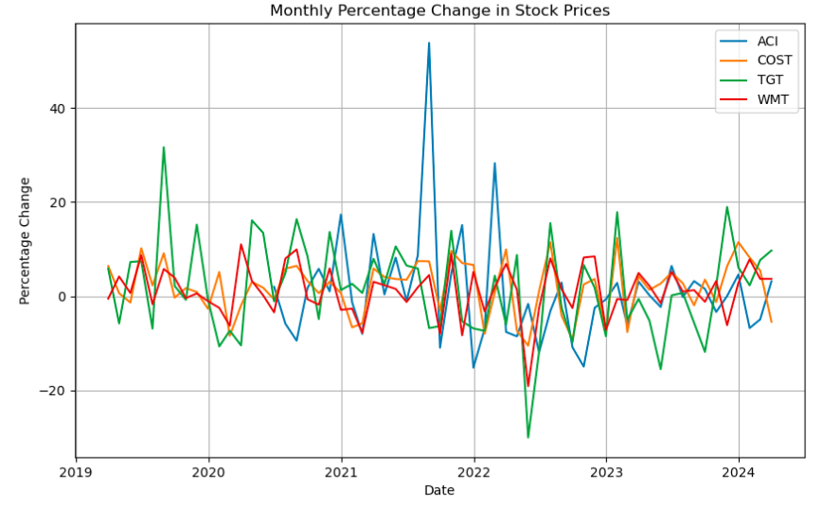
HOW DOES THE STOCK PRICE CHANGE OVER TIME?
NB – Albertsons has only been trading in its current form since Mid 2020

Slide 9
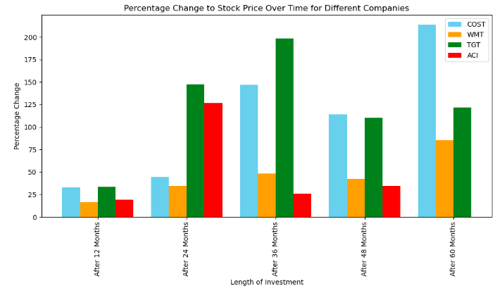
HOW DOES THE STOCK PRICE CHANGE OVER TIME?
Assumptions:
The original opening price was found and then compared to the closing price 12, 24, 36, 48 and 60 months later.
NB - ACI has not been traded in it’s current form for 60 months.

Slide 10
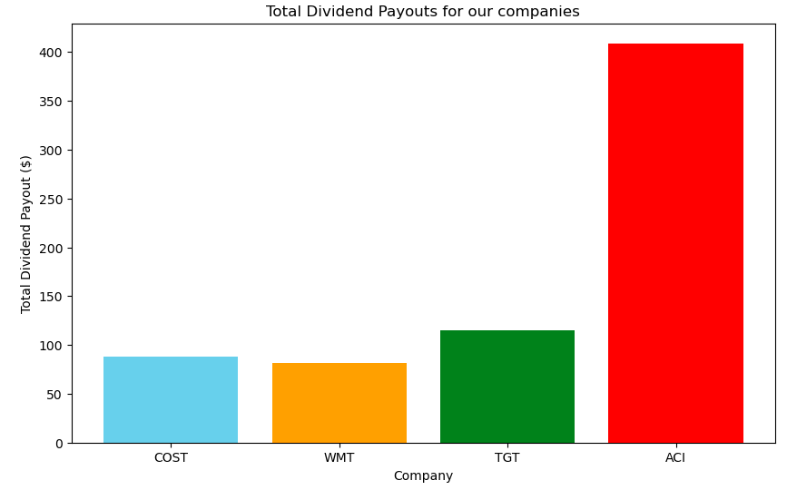
HOW ARE DIVIDENDS TREATED BY THE COMPANY?
Assumptions:
$1000 was used to buy shares.
The shares were not traded throughout the 5 year period – or for the period of time that Albertson’s was listed.
No additional shares were purchased.

Slide 11
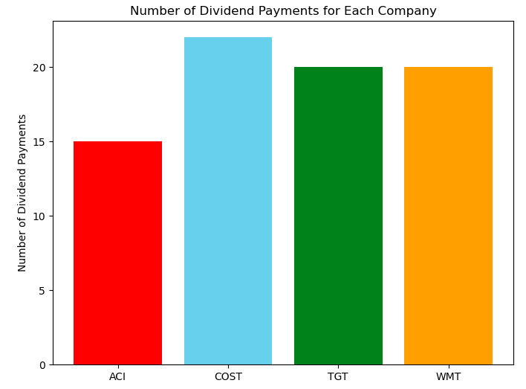
HOW ARE DIVIDENDS TREATED BY THE COMPANY?

Slide 12
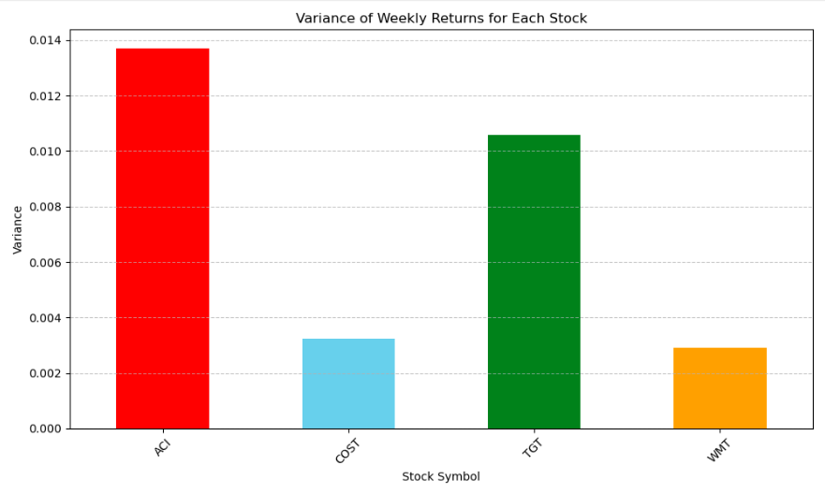
HOW VOLATILE IS THE STOCK?

Slide 13
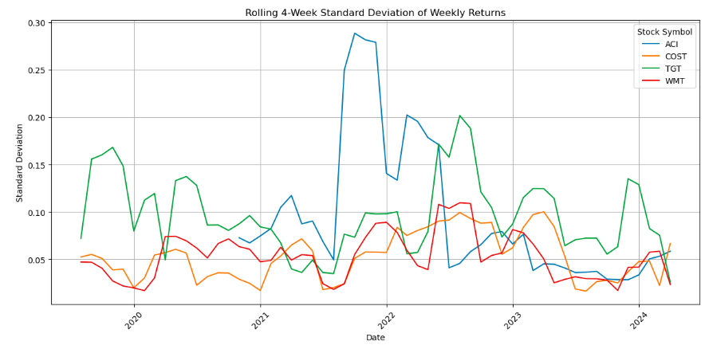
HOW VOLATILE IS THE STOCK?

Slide 14
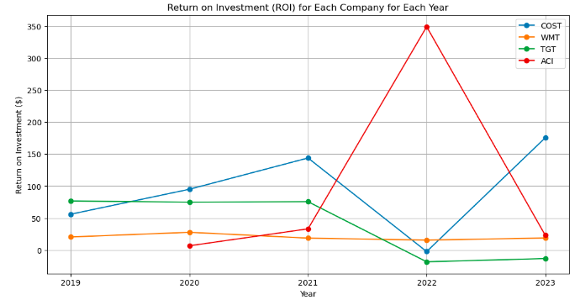
WHAT IS THE RETURN ON INVESTMENT?

Slide 15
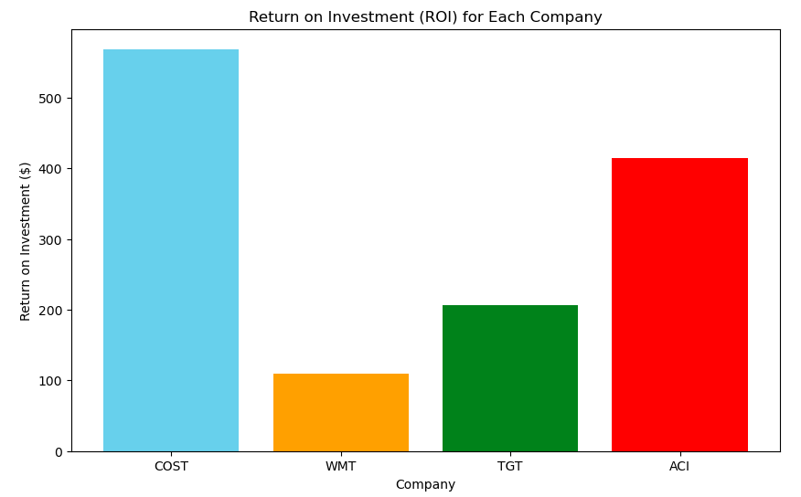
WHAT IS THE RETURN ON INVESTMENT?
Assumptions:
Initially $1000 was invested.
ROI is the sum of all dividend payouts and stock price increase over the 5 year period for all bar ACI.
ACI – the same operations were performed, but only for the time period that they are trading in their current form.

Slide 16
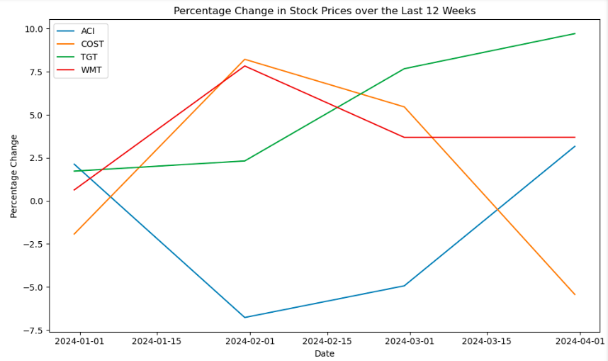
IS PAST FINANCIAL PERFORMANCE A TRUE INDICATOR OR FUTURE FINANCIAL PERFORMANCE?
Notes:
When we look at percentage change over the last 12 weeks TGT is the only

Slide 17
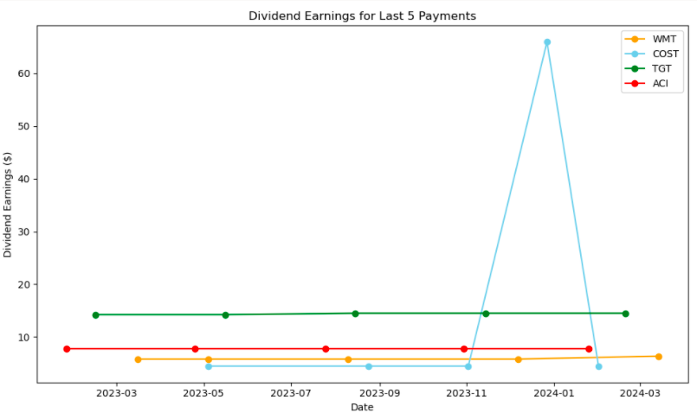
IS PAST FINANCIAL PERFORMANCE A TRUE INDICATOR OR FUTURE FINANCIAL PERFORMANCE?
Assumptions:
$1000 worth of stock was invested using the original opening price - and used to calculate the number of shares held.
Dividend earnings is the number of shares held multiplied by the dividend per share to give a total amount per dividend issue..
Notes:
Costco is at it’s lowest for dividend earnings from may till November it only get to its peak in January which is not a true indicator

Slide 18
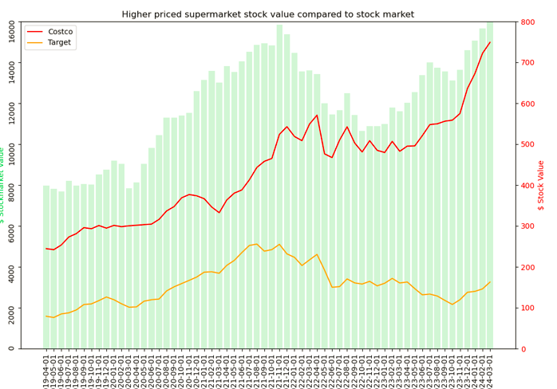
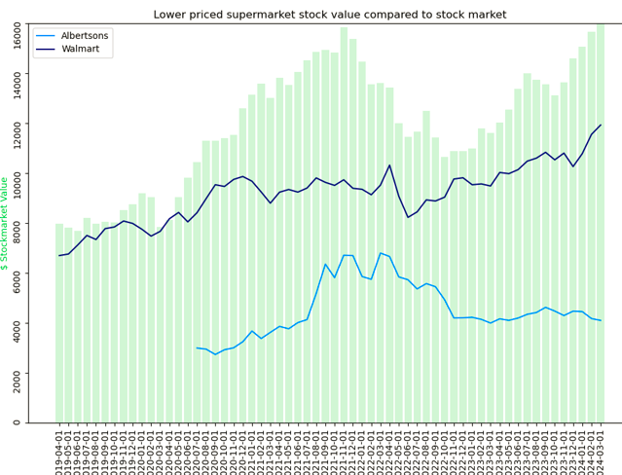
ARE THERE ANY OTHER FACTORS THAT CAN INFLUENCE OUR DECISION?

Slide 19
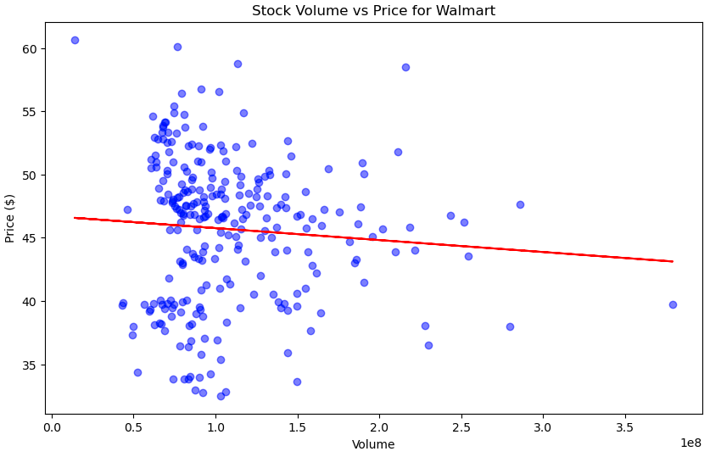
ARE THERE ANY OTHER FACTORS THAT CAN INFLUENCE OUR DECISION?
Correlation Co – efficients:
Walmart: -0.077
Costco: -0.151
Target: -0.272
Albertsons: -0.118

Slide 20
ARE THERE ANY OTHER FACTORS THAT CAN INFLUENCE OUR DECISION?
Walmart - aggressive expansion plans - will it work?
Albertson’s - implications of a blocked merger?
Costco - an over - reliance on membership numbers?

Slide 21
SO WHO SHOULD WE INVEST IN BASED ON THIS DATA?
Based on total ROI, it is hard to look past Costco!
This is in spite of in one year ROI was 0 - but for the other years, ROI was consistently above the other chains.
However, over the last 3 months, its share price has declined - do we think this is a pattern of things to come?
Total dividend payments are less relevant for Costco - its share price is a lot higher than the others so $1000 buys less shares compared to the others - so the vast majority of any return is generated by the share price increasing.

Slide 22
FURTHER CONSIDERATIONS
Before any decision is made, further scrutiny of the company would need to be done – for example, examining the Trading Profit and Loss Account and Balance Sheet and performing other statistical measures such as the “Acid Test”.
What is your investor / risk profile? Are you a Pension Fund Manager or a day trader? A Day trader may be prepared to absorb a higher level of risk than a Pension Fund Manager who has to ensure that any trades will cover their commitments no matter what.
Are there other sectors who are greatly outperforming this one – and would be a more attractive investment opportunity?

